Slide 1


Electrical Machinery Fundamentals
EE 250 SPRING 2021
Lecture 2
Instructor: Dr. Aashir Waleed

Slide 2
Chapter 4 Direct-Current Generators

Slide 3
4.1 Generating an AC voltage
DC is inherently AC and is converted to DC by rectification by the commutator
Rotation due to some external force. e.g., motor
Uniform speed=> Voltage as a function of time.

Slide 4

4.2 Direct-Current Generators
Brush switching from one slip ring to another when polarity is about to change.
Usage of commutator(Slip ring cut in half and is insulated from one another).

Slide 5
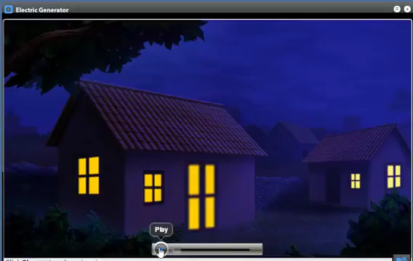
4.2 Direct-Current Generators

Slide 6
4.3 Difference between AC and DC Generators
Differ in the way the coils are connected to external circuit
AC generator carry slip rings
DC generator carry commutator

Slide 7
4.4 Improving the wave shape
Lap Winding
Armature construction
Improving pulsating DC voltage by using 4 coils
Flux cutting depends upon the position of coils in the magnetic field.

Slide 8
4.4 Improving the wave shape
e_{a} and e_{b} will be equal and opposite in polarity
So, e_{a} + e_{b} + e_{c} + e_{d} =0
So no current will flow in closed loop=> No I²R
45°
Ripple Factor= RMS AC value to DC Value
5% in modern DC Generators

Slide 9
4.4 Improving the wave shape
45°

Slide 10
4.5 Induced voltage
Neutral position: Short circuit the coils with zero induced voltage
Sparking if brushes shift at some rotation from neutral axis (poor commutation)
Large currents flow

Slide 11
4.6 Neutral zones
Neutral zones: Those places on the surface of armature where flux density is zero
When generator operates at no load then neutral zones located exactly between the poles
Always set brushes with the coils that are momentarily at neutral zones

Slide 12
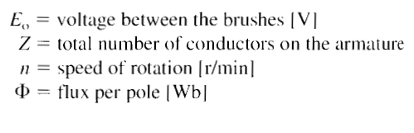
4.7 Value of induced voltage
Induced voltage in DC generator with lap winding is given as:
This is valid only if brushes are at neutral positions

Slide 13
4.8 Generator under load
Current flows in the same direction in the conductors that are momentarily under pole N => same for conductors under S pole but opposite in direction as that of conductors under S pole
Direction of current:
N: Out of board
S: Into the board

Slide 14
4.8 Generator under load
Torque(due to F) in opposite direction to that of direction of rotation
We need to provide torque on shaft to counter the opposite directional torque due to F
Resultant mechanical power is converted into electrical power that is delivered to load

Slide 15
4.9 Armature reaction
mmf due to armature winding(under load) distorts flux coming from poles. (Armature reaction)
→This effect takes place in both motors and generators
Intensity of armature flux depends upon MMF of armature which depends upon the current.
Contrary to flux due to fixed poles armature flux varies with the load
Armature flux is at right angle to the flux due to poles.
Under load Condition

Slide 16
4.9 Armature reaction
Neutral zones (Shifted in the direction of rotation) :
Flux no longer zero=> Voltage will be induced=> Current will flow => Short-circuiting=> sparking
High flux density at pole tips 2,3
Increase in flux at 2,3 is less than that of flux at 1,2 => Flux by poles is less under load than that of under no load => Reduction in induced voltage

Slide 17
4.10 Shifting the brushes to improve commutation
Neutral zones shifted => Sparking will occur
Brushes must be shifted to get good commutation
Neutral zones fluctuated in position depending upon the load.
Shifted at intermediate position for good commutation under all loads
Suitable for low power DC machines

Slide 18
4.11 Commutating Poles
Counter the effect of armature in medium and large power DC machines.
Connected in series with armature
No of turns on commutating poles such that: mmf_{c}=mmf_{a}
Load varies => both mmf varies and nullify the effect of each other
As a result, no flux in neutral zones=> No need to shift brushes.
Fix field distortion problem in small portion.

Slide 19
4.12 Separately excited generator
Electromagnets (called field poles) instead of permanent magnets.
DC field current supplied by an independent source (battery/ another generator) called exciter.

Slide 20
4.13 No-load operation and saturation curve
Flux per pole versus exciting current
Change in exciting current=> Change in induced voltage:
Increase Ix => Increase in mmf => Increase in flux per pole
Unsaturation
Saturation
Saturation begins to be important when we reach the “knee” of saturation curve.
No-load saturation curve

Slide 21
4.13 No-load operation and saturation curve
Flux per pole versus exciting current
Saturation curve vs. Induced voltage:
Generator running at constant speed =>
E_{o} ∝ φ
Induced voltage vs. Speed:
Direct proportion
Induced voltage Polarity change by changing direction of exciting current.
Polarity also changes by changing direction of rotation.
No-load saturation curve

Slide 22
4.14 Shunt generator
Self excitation
Shunt-field winding are connected in parallel with armature terminal
No need of external source for excitation
How self-excitation is achieved?
Starting generator
Small induced voltage in armature due to residual flux=> Small voltage builds up exciter current => Increase in mmf => Increase in flux => Increase in induced voltage E_{o}

Slide 23
4.15 Controlling the voltage of a shunt generator
Maximum voltage generated by shunt generator
Vary the exciting current by means of rheostat.
To find no-load value of generator:
Saturation curve of generator must be known
Total resistance must be known between p & b
Draw straight line corresponding to slope of R_{t}
Critical resistance where induced voltage drops to zero. Here it is 200 ohms

Slide 24
4.16 Equivalent circuit
R_{o} =Total resistance of armature:
Measured on commutators that lies at brushes
1,2 are external armature terminals of the machine.
F₁ and F₂ are field winding terminals.

Slide 25
4.17 Separately excited generator under load
Running at constant speed
Field is excited by battery
Exciting current is constant and so the flux
So E_{o} is fixed (under no load condition)
Induced voltage decreases as the load increases because the
current increases => voltage drops across R_{o.}
So terminal voltage E₁₂ is less in case of loading condition.
Load curve of the generator

Slide 26
4.18 Shunt generator under load
Terminal voltage of shunt generator under loading falls more rapidly as compared to separately excited generator
Reason: In shunt generator as terminal voltage drops => Field current drops and so the flux decreases
In shunt : Drop from no-load to full-load is about 15%
In separately excited generators : Drop from no-load to full-load is about less than 10%.
Voltage Regulation

Slide 27
4.19 Compound generator
Compound generator needed to prevent terminal voltage drop in case of loading
Extra Series Winding, which in turn improves Eo.
Over-compound generator: Extra turns for compensating IR drop in feeder line b/w generator and load.
For strong compounding: Low resistance addition in parallel with series field (same effect as reducing number of turns) reduces the current in series field.

Slide 28
4.20 Differential compound generator
mmf of series field acts in opposite direction to that of shunt field => terminal voltage drops drastically
How to form DCG : simply alter the connection of series field windings.
Used in DC arc welders.
Voltage regulation for differential compound =
(No-Load – Full-Load)/Full-Load

Slide 29
4.21 Load characteristics
Voltage Regulation under loading condition:
Over-compound : +10%
Compound : almost constant
Separate excitation : -10%
Shunt : -15%
Differential compound : -30%

Slide 30
4.22 Generator specifications
The nameplate of DC generator indicates the power, current, insulation class, etc of the machine.

Slide 31

Construction of DC generators

Slide 32
4.23 Field
Permanent magnets
Electromagnets
Field windings are wound so that two adjacent poles are opposite in magnetic polarities.

Slide 33
4.24 Armature
Rotating part of DC generator
Consist of : Commutator , Iron core and set of coils
Iron core: Composed of slotted , iron and laminations => Decrease in eddy current losses
Insulation done with many layers of papers and are firmly held in place by fiber slot sticks
Cross-sectional view

Slide 34
4.25 Commutator and brushes

Slide 35
Summary
Topics: 4.1-4.22
Assignment: Example 4.1

